Slide 1



Gonzalo Zurita

Slide 2
Table of Contents
01
04
02
05
Regression Model predictions
Introduction
Analysis of the data
Conclusions
03
06
Time-series predictions
Next steps

Slide 3
01
Introduction

Slide 4
What is the Bitcoin?
Cryptocurrency: decentralized digital currency
Market cap
2009
More than one trillion market capitalization
4,09%
Foundation
Volatility Index
Founded by Satoshi Nakamoto (anonymous)
$1 T.
Cryptocurrencies are know for their high volatility

Slide 5
02
Analysis of the data
Analysis of the relationship between the price of Bitcoin and other features

Slide 6
Where is the data from?
API
DS
Cryptocompare.com
Online Datasets
BTC
ETH
BNB
ADA
XRP
GOLD
EUR/USD
GBP/USD
USD/JPY

Slide 7
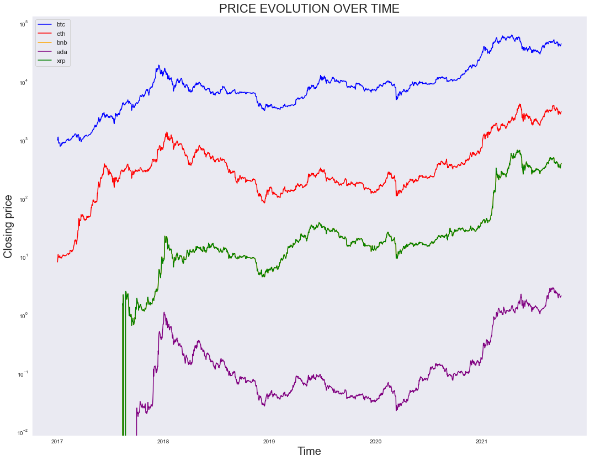
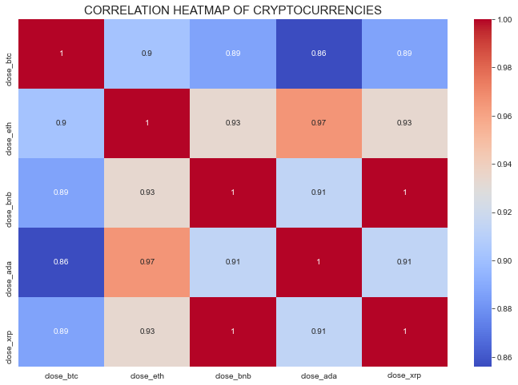
BTC vs. other cryptocurrencies

Slide 8
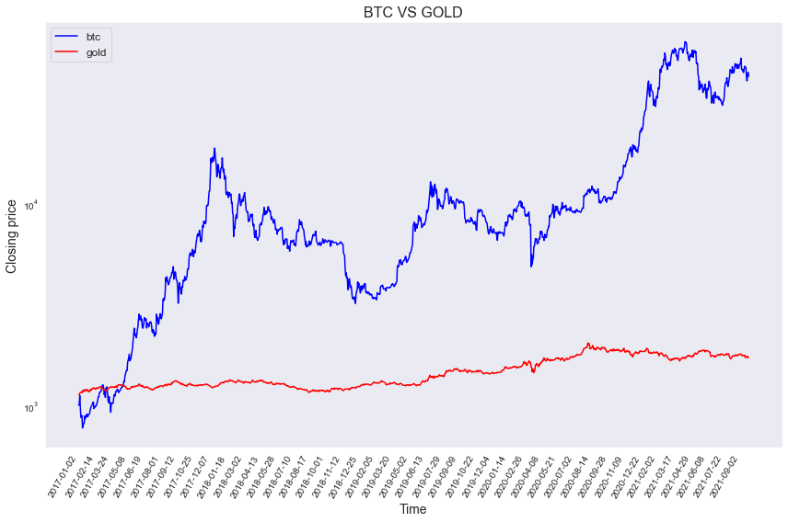
BTC vs. Gold
Correlation BTC & Gold
0,64

Slide 9
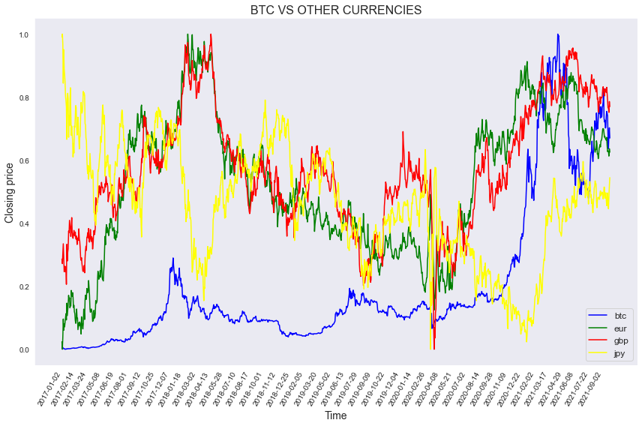
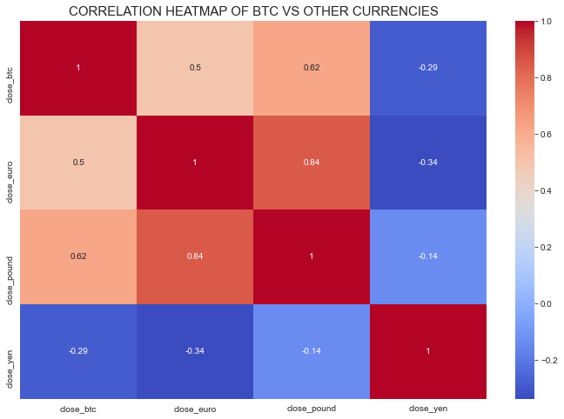
BTC vs. other currencies

Slide 10
Time-series predictions
03
Analysis of the predictions made by the Prophet and SARIMAX models

Slide 11
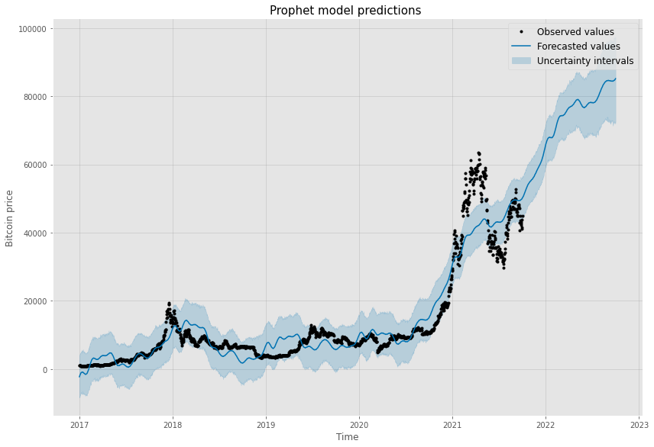
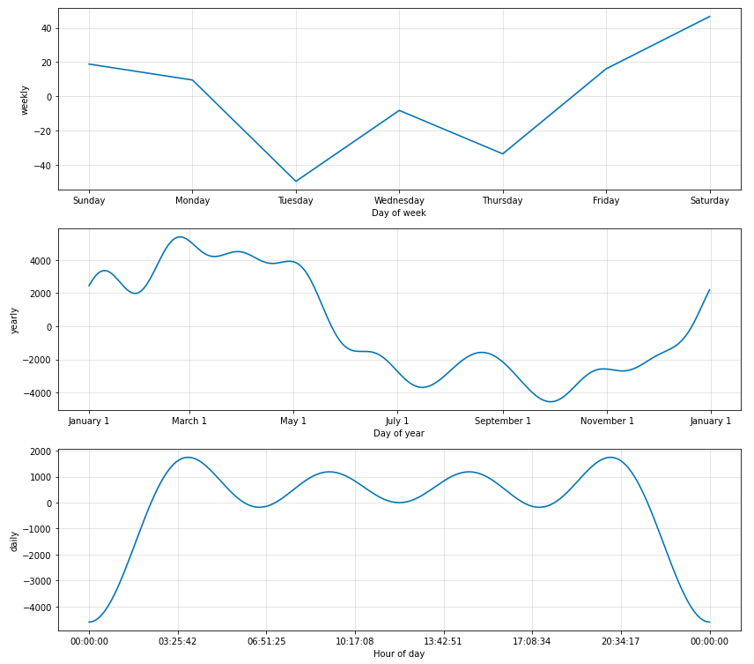
Prophet model predictions

Slide 12
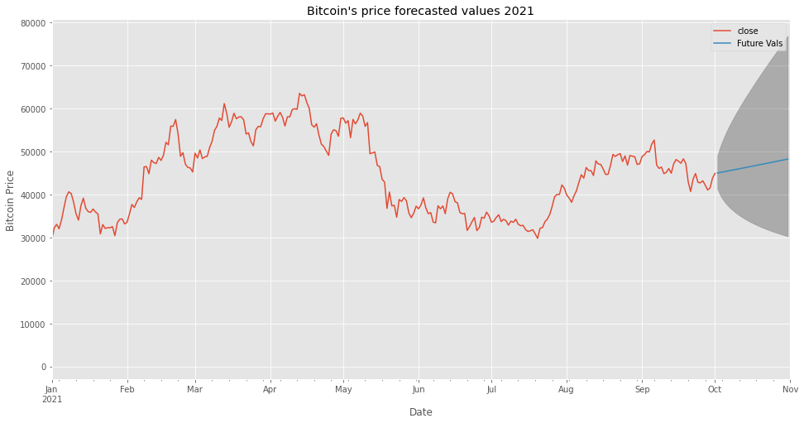
SARIMAX model predictions

Slide 13
Comparative of the predictions
Date: 15/10/2021 | Closing Price ($)
Prophet Model | 52,610.14
SARIMAX | 46.441.04
Volatility index: 4.09%

Slide 14
04
Regression Models Predictions
Analysis of the predictions made by 5 regression models

Slide 15
Regression models results
Features:
ETH
BNB
ADA
XRP
Gold
EUR/USD
GBP/USD
USD/JPY
Target ➔ BTC closing price
Model | Score | MAE
XGB | 0.9815 | 0.0102
Decision Tree | 0.9725 | 0.0118
Linear Regressor | 0.8740 | 0.0541
KNN | 0.9906 | 0.0113
Random Forest | 0.9793 | 0.0102

Slide 16
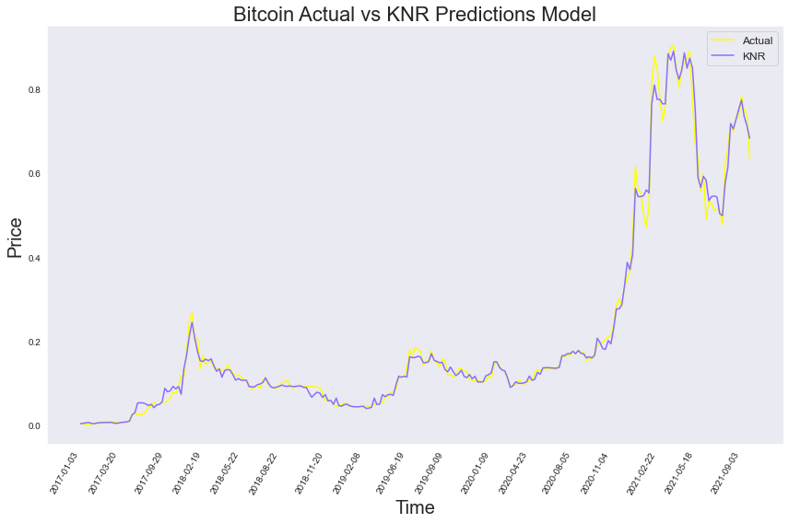
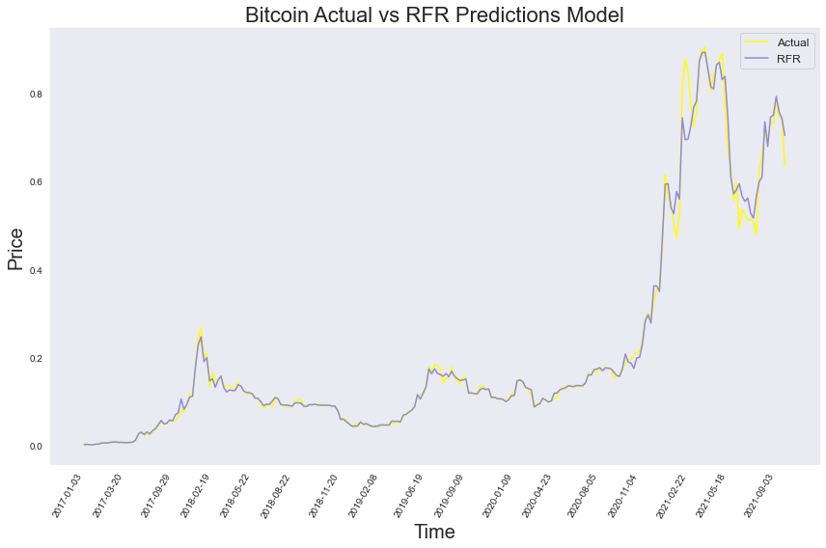
KNR and RFR predictions
Notes:
The fact that the results of the model are so high was predictable since the correlation of the features to the target is very high, so the conclusion we get form this is that by knowing the value of the features we are able to predict the value of bitcoin.

Slide 17
05
Conclusions

Slide 18
1
High correlation between the BTC and the other cryptocurrencies, gold, euro and pound
4
The best regressor model for predicting BTC with these features are KNN and RFR
2
Both time-series model predict that the BTC price is increasing in the ST
5
By knowing the value of the studied features, we are able to predict the price of BTC
3
For making profit: buy on a Tuesday in October, sell on Saturday at the end of February

Slide 19
"Historical data is a great indicator but never a guarantee of the future, and statistical models are never correct — only useful"
Sebastian Quintero
Notes:
By this I mean that it is impossible predict the exact value of crypto currencies in the feature, because it depends on an infinite number of random variables that are impossible to to incorporate in a model.
However, making predictions based on past values and other features is interesting to understand the behavior of these currencies and see how they may react in the future.

Slide 20
06
Next Steps

Slide 21
Next Steps
Since all crypto’s prices are so extremely highly correlated ➔ get hourly data of the prices of cryptos and analyze which one of them initiates the tendencies, and by closely monitoring that crypto it will be possible to predict value of the other cryptos.
After knowing the high correlation between the price of cryptos, gold and other currencies, create a regression model that is able to predict future BTC values taking into account these features.

Slide 22
Thank you!
And please don’t use this as financial advise!

